Slide 1

Fundamentals of AWS

Slide 2

What is Cloud?
Someone else’s Computer?
A collection of Services that create a platform
Media Services
Databases
Security
Virtual Servers
Networking
Machine Learning
Data Storage
Analytics

Slide 3
Definition
"AWS is the world's most comprehensive and broadly adopted cloud platform, offering over 200 fully featured services from data centers globally. Millions of customers, including the fastest growing startups, largest enterprises and leading government agencies are using AWS to lower costs, become more agile and innovate faster."

Slide 4

Billed by second for using Services
60 seconds minimum
Use 83 seconds, get charged for 83 seconds
Lambda recently moved to per millisecond billing

Slide 5
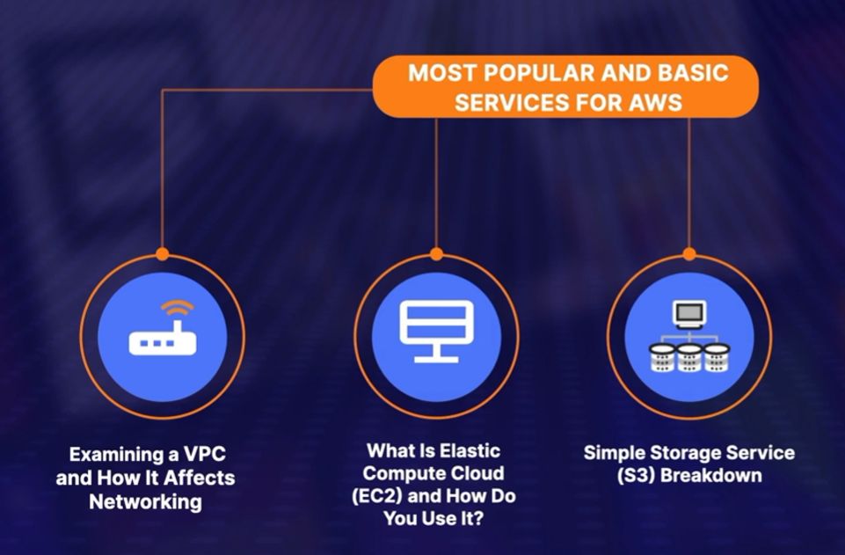
Most Popular and Basic Services for AWS

Slide 6
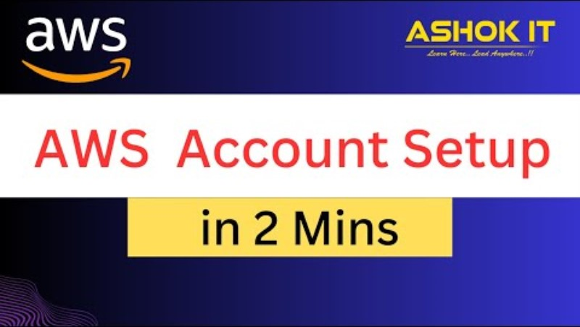

Slide 7
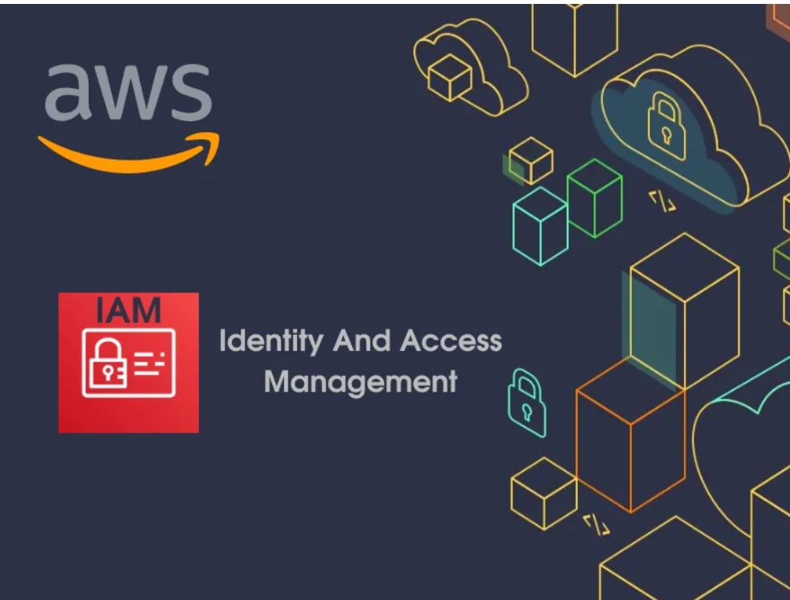

Slide 8
How Identity and Access Management Works?
AWS(Amazon Web Services) will allows you to maintain the fine-grained permissions to the AWS account and the services provided Amazon cloud. You can manage the permissions to the individual users or you can manage the permissions to certain users as group and roles will helps you to manage the permissions to the resources.

Slide 9
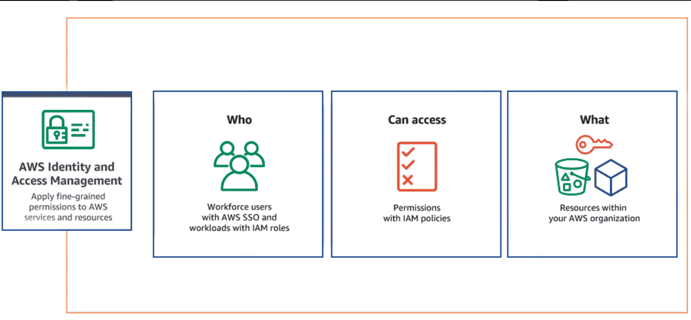
Manage users and their level of access
Used to set users, permissions and roles
Grant access to the different parts of the aws platform

Slide 10


Create a directory of users called identities, and they can be users inside of your AWS account or users outside of your AWS account. Some of these users may need access to your website and services. Along with managing this directory, you manage what they can do once they log in.
You can group identities to manage shared permissions and assign access permissions, using security policies and roles

Slide 11
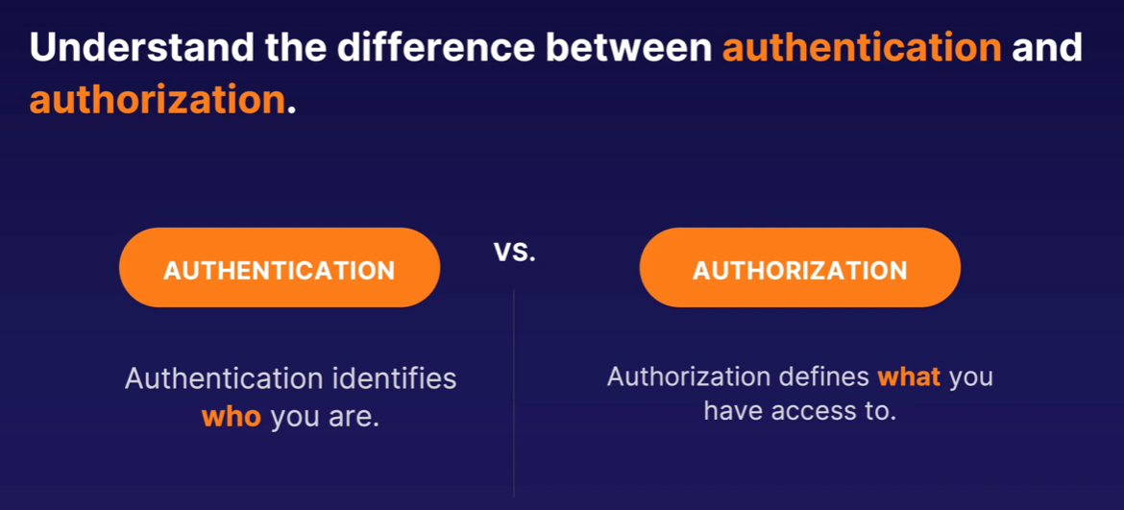

Slide 12
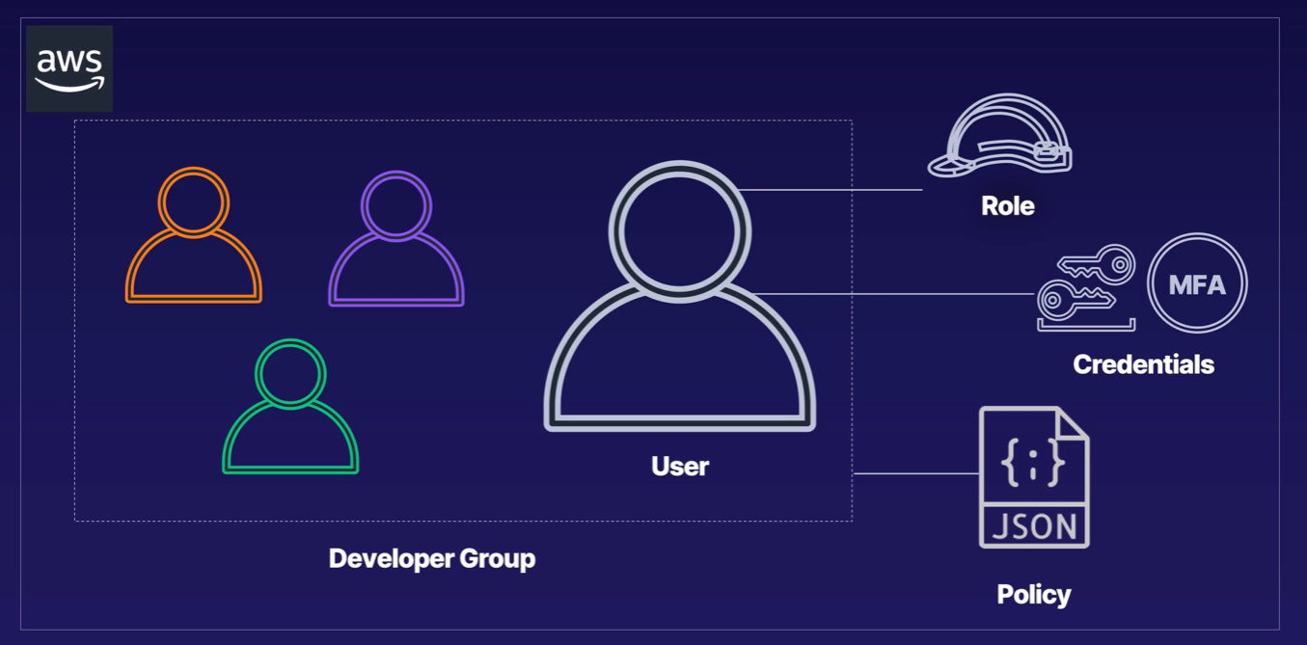
User is an identity.
Users can be placed in groups. All users within a group share the same permissions.
Perform a specific duty using a role.
Policy with granular level permissions.

Slide 13
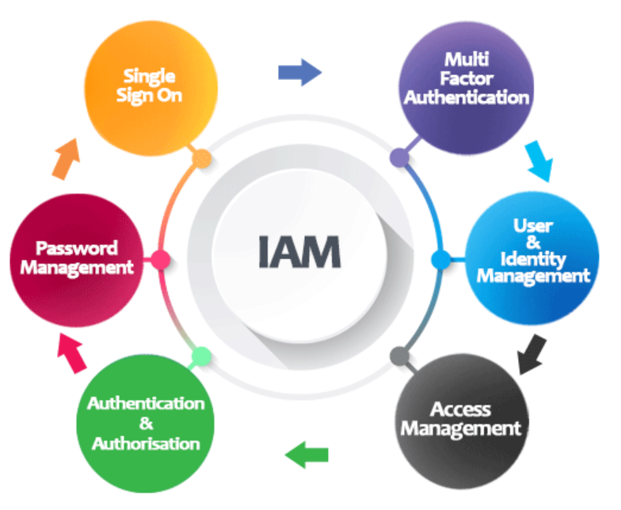
Key Components of IAM

Slide 14
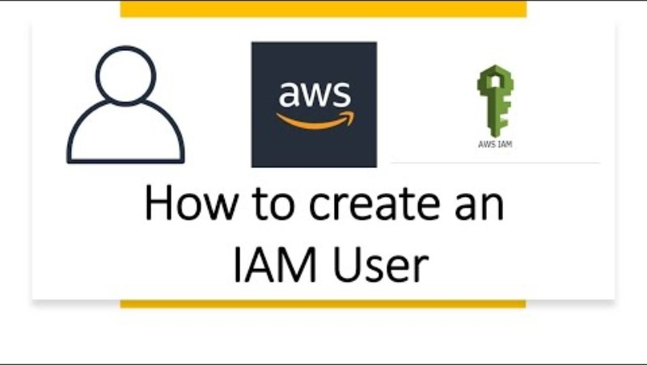

Slide 15
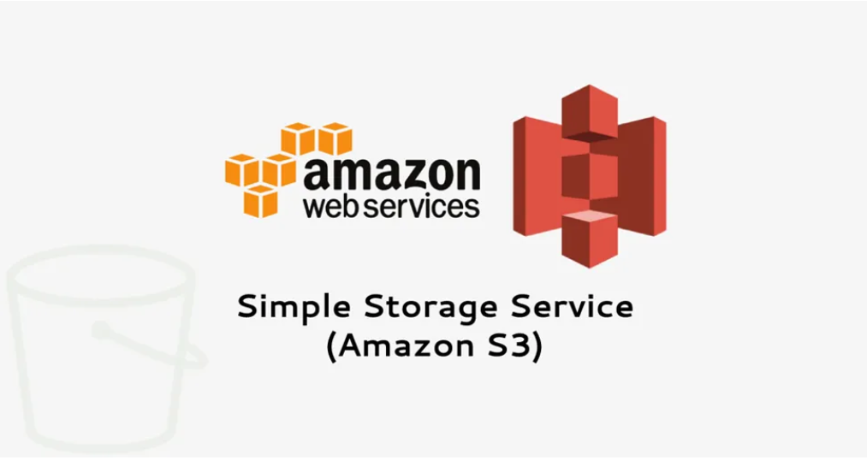

Slide 16

Simple Storage Services (S3)
Store infinite amount of data
Highly scalable, reliable, fast, inexpensive data storage infrastructure
Storage for:
Internet applications
Backup and recovery
Disaster recovery data archives
Data lakes for analytics
Hybrid cloud storage.

Slide 17
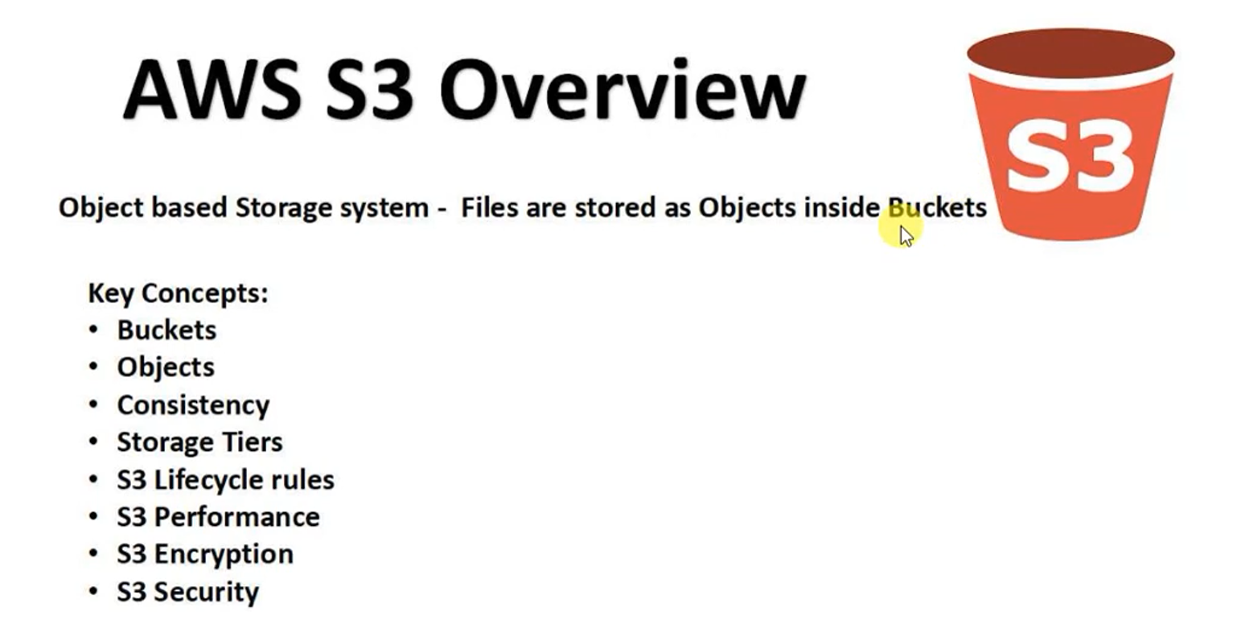

Slide 18
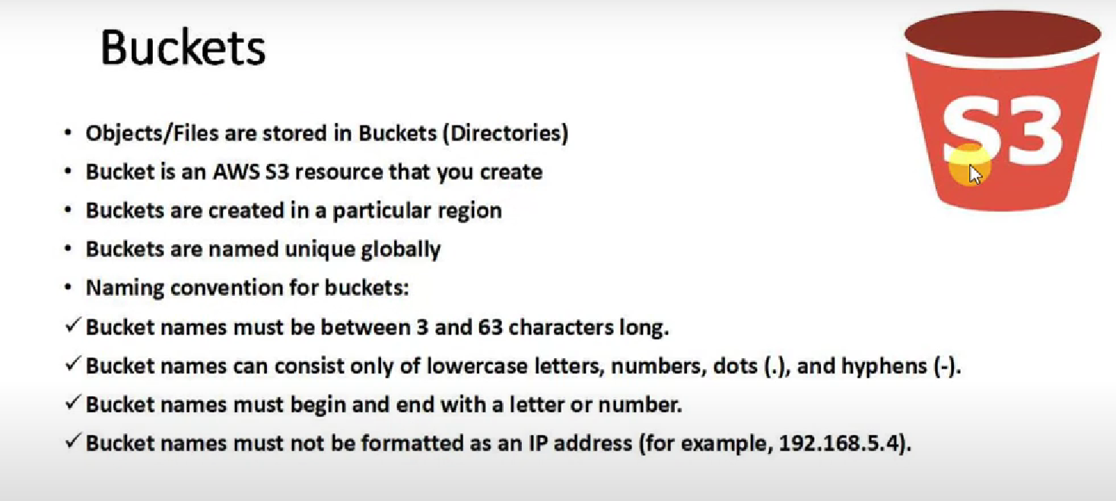

Slide 19
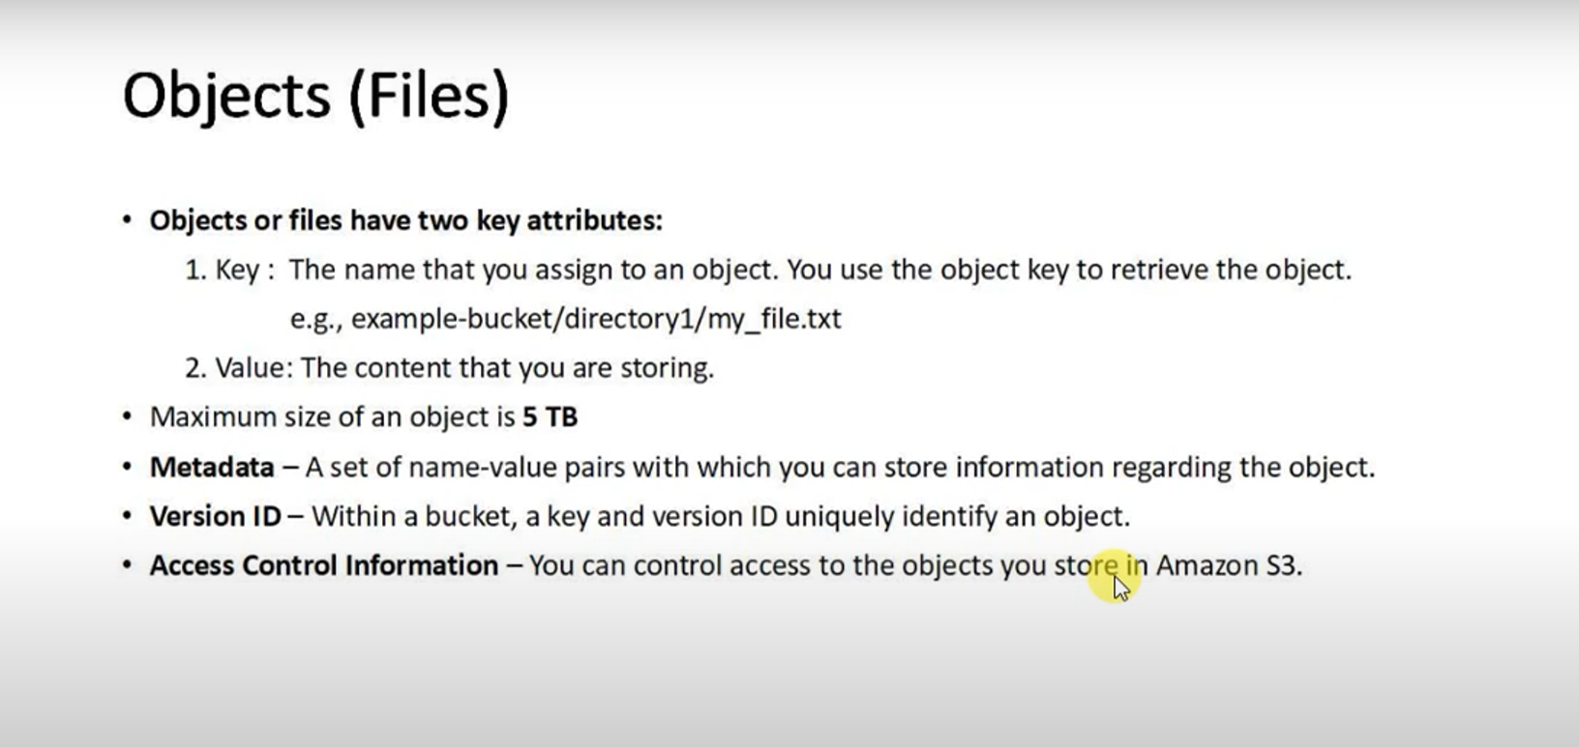

Slide 20
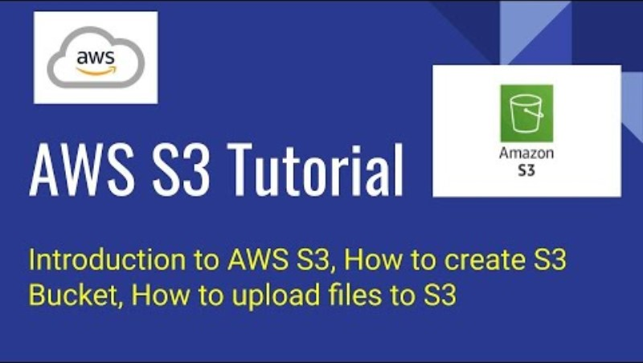
Play from 7:00

Slide 21
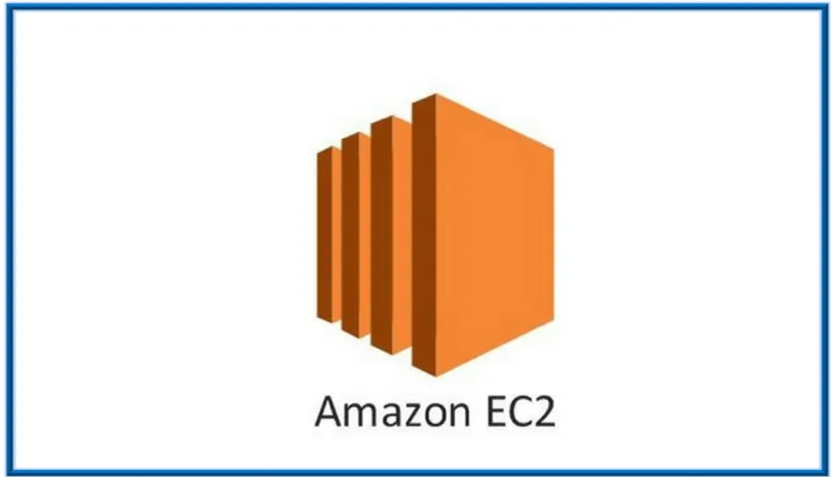

Slide 22
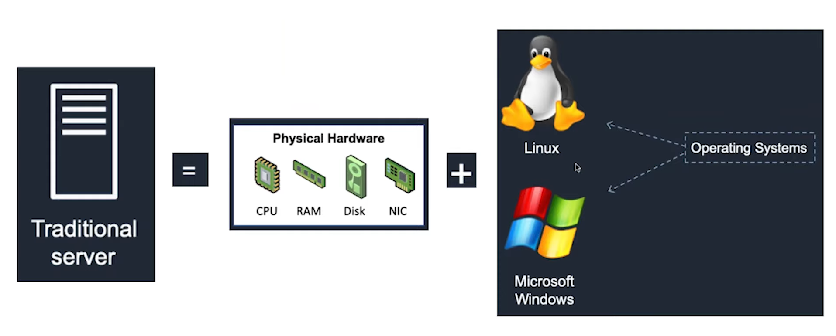
Elastic Compute Cloud EC2

Slide 23
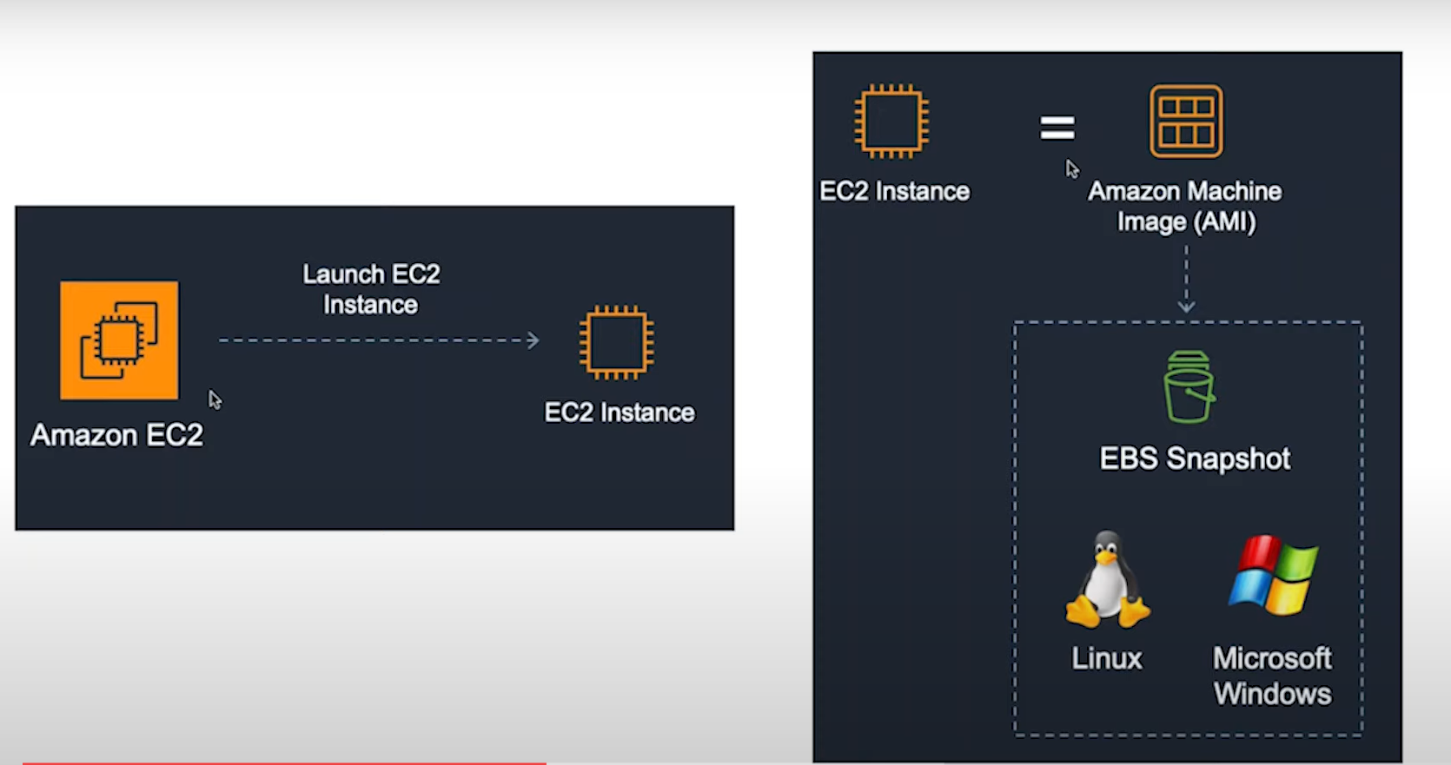
Elastic Compute Cloud EC2

Slide 24
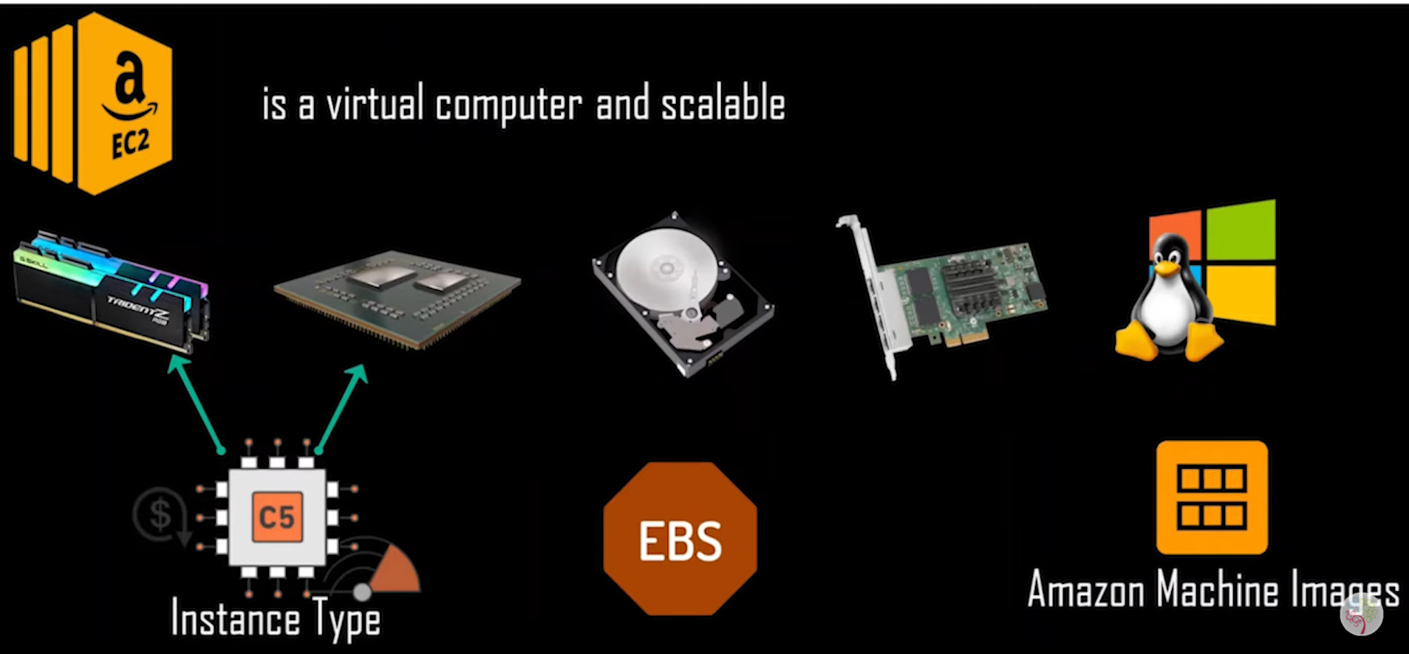
Elastic Compute Cloud EC2

Slide 25
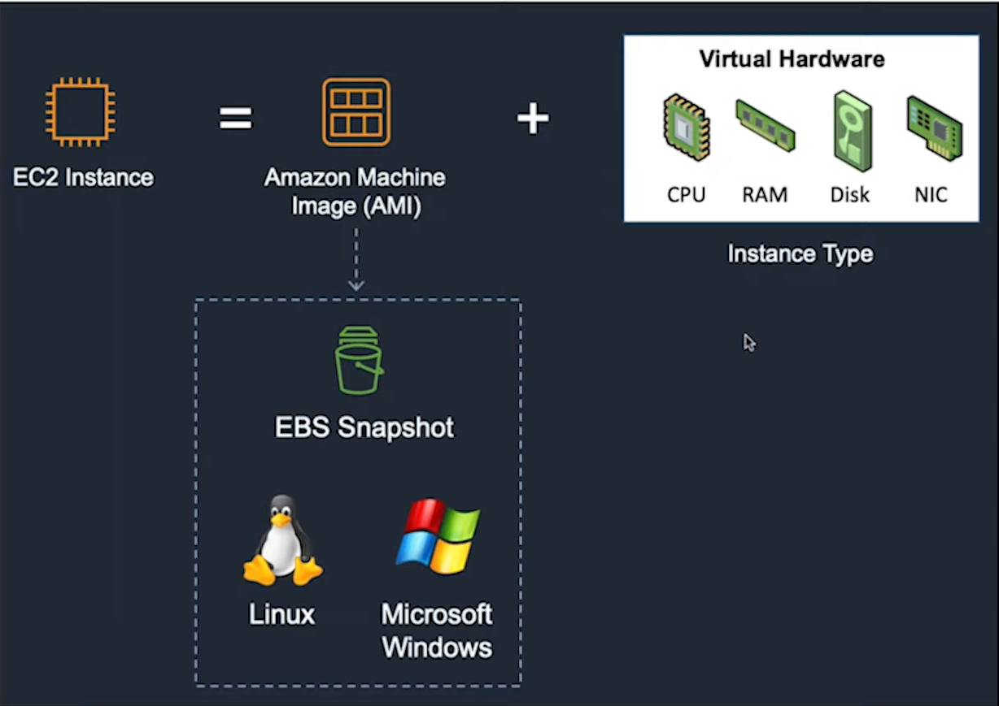
Elastic Compute Cloud EC2

Slide 26
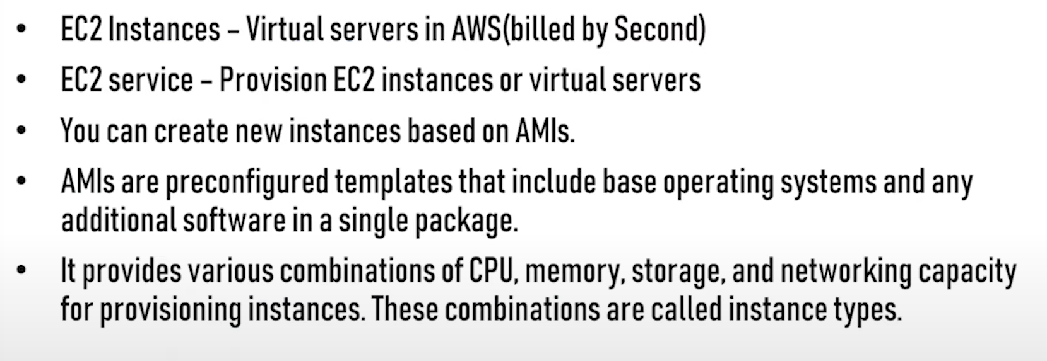
Elastic Compute Cloud EC2

Slide 27
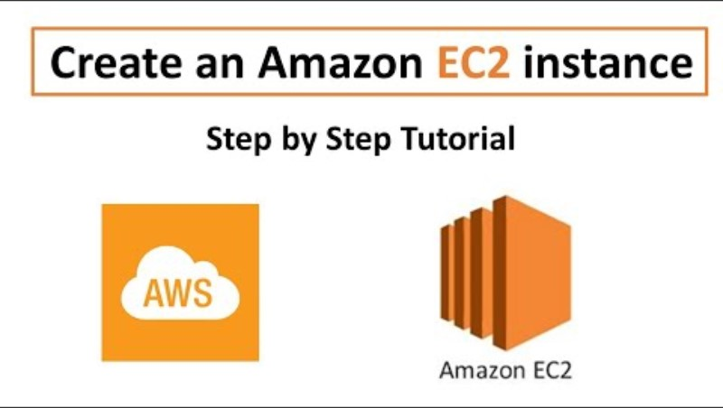
Elastic Compute Cloud EC2

Slide 28
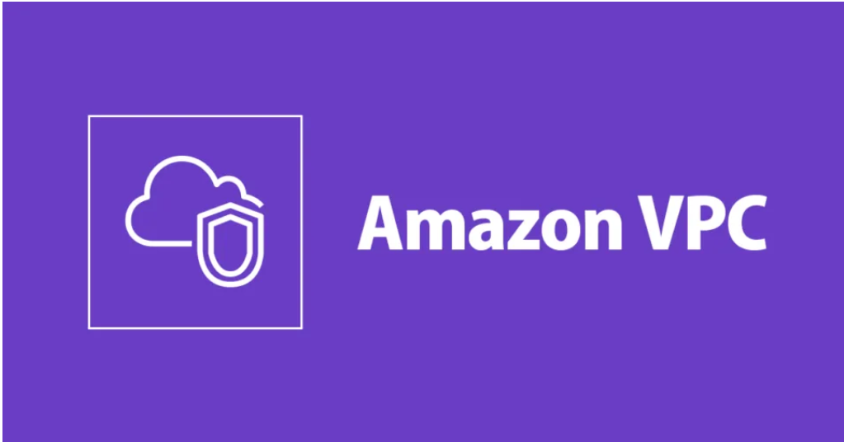

Slide 29
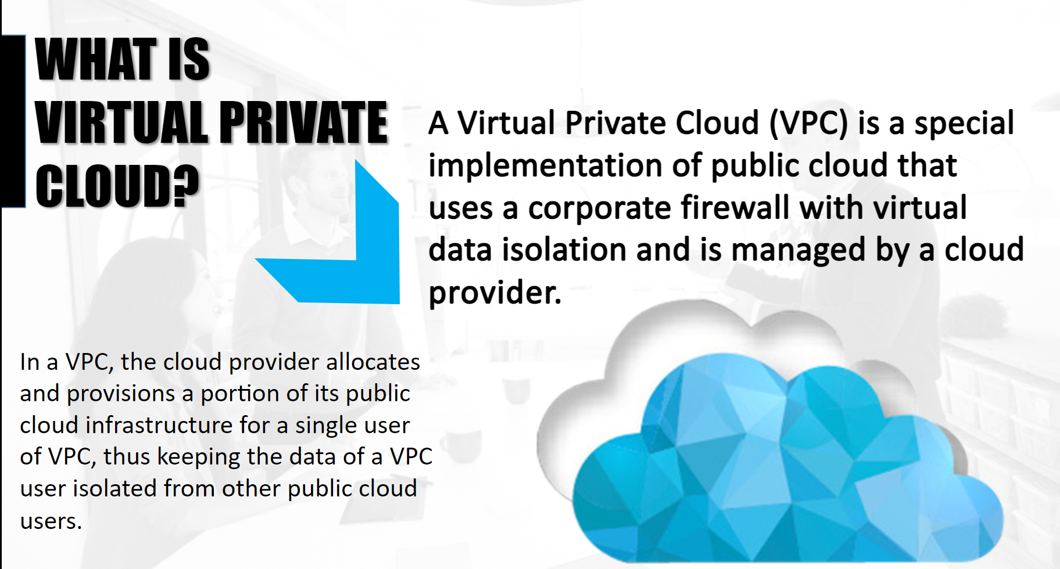

Slide 30
